Slide 1
Real time Facial Expression Recognition using Deep Learning
By:
Isha Talegaonkar, Kalyani Joshi, Shreya Valunj, Rucha Kohok, Anagha Kulkarni
MKSSS’s Cummins College of Engineering for Women, Pune – 411052
17th May 2019

Slide 2
Introduction
Human computer Interaction has become very important in the digital era.
Face expressions are a key feature of non-verbal communication
The FER model created using CNN is used to detect facial expressions in real time.
Applications of FER:
Advertising – used by Coca Cola
Risk assessment of car drivers
Customer interest evaluation
Medical rehabilitation

Slide 3
Literature Survey
Paul Ekman studied facial anatomy and produced six universal expressions in his study.
Affectiva, and Microsoft’s Emotion API are some of the existing FER systems

Slide 4
Dataset
FER2013 dataset from the Kaggle challenge on FER
Size of images: 48x48
Black and white images
Images that vary in viewpoint, lighting, and scale.
Purpose | No. of Images
Training | 35,887
Public Test | 3,589
Private Test | 3,589

Slide 5
Methodology

Slide 6
Pre-processing
Resizing of image
Normalization
Grayscaling

Slide 7
Face Detection
Haar Cascades are used for face detection
Classifiers which detect an object in an image or video for which they have been trained.
Haar features are used

Slide 8
Emotion Classification
System classifies the image into one of the seven expressions using CNN
CNN are a category of neural networks proved to be productive in image processing
Data was split into training and test sets
State of the art results obtained by experimenting with layers.

Slide 9
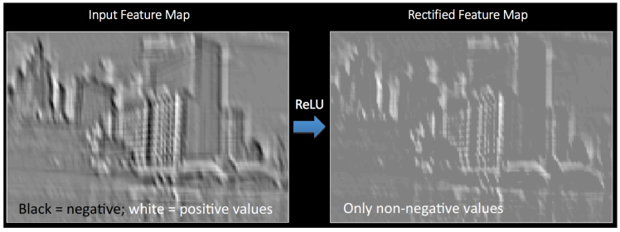
Convolutional Neural Networks
Convolution step:
Activation function:

Slide 10
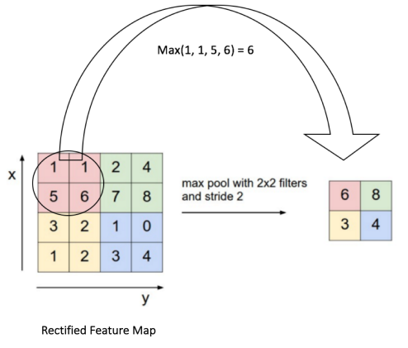
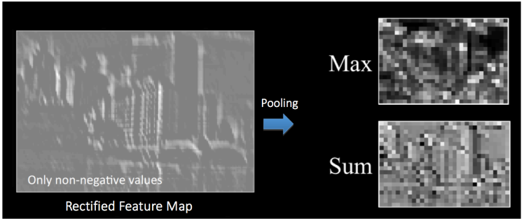
Pooling step:

Slide 11
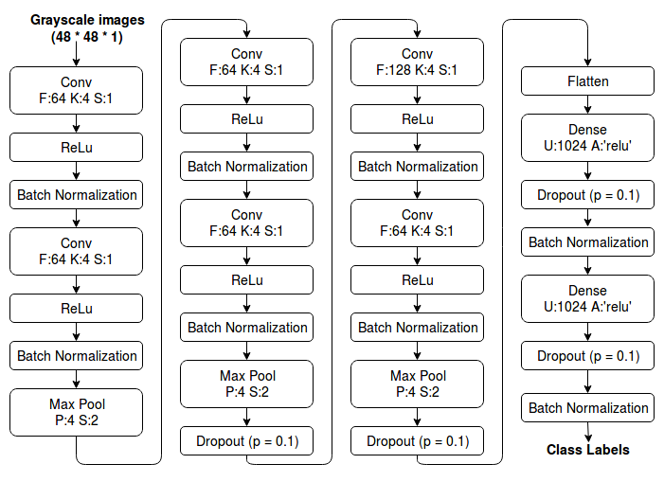
CNN
Architecture

Slide 12
Results
Results were obtained by experimenting with the following parameters:
Filters
Number of epochs
Number of layers
Results obtained over three experiments using CNN:
Experiment | Training Accuracy | Test Accuracy | Validation Accuracy
Experiment 1 | 63.22 | 56.56 | 89.01
Experiment 2 | 68.37 | 58.03 | 89.61
Experiment 3 | 79.89 | 60.12 | 89.78

Slide 13
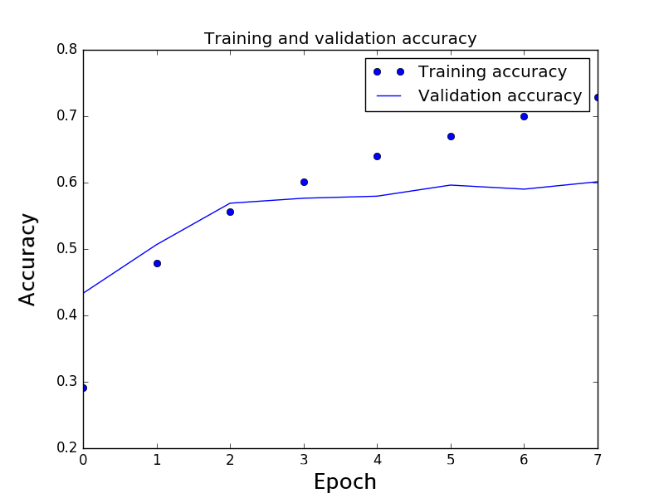
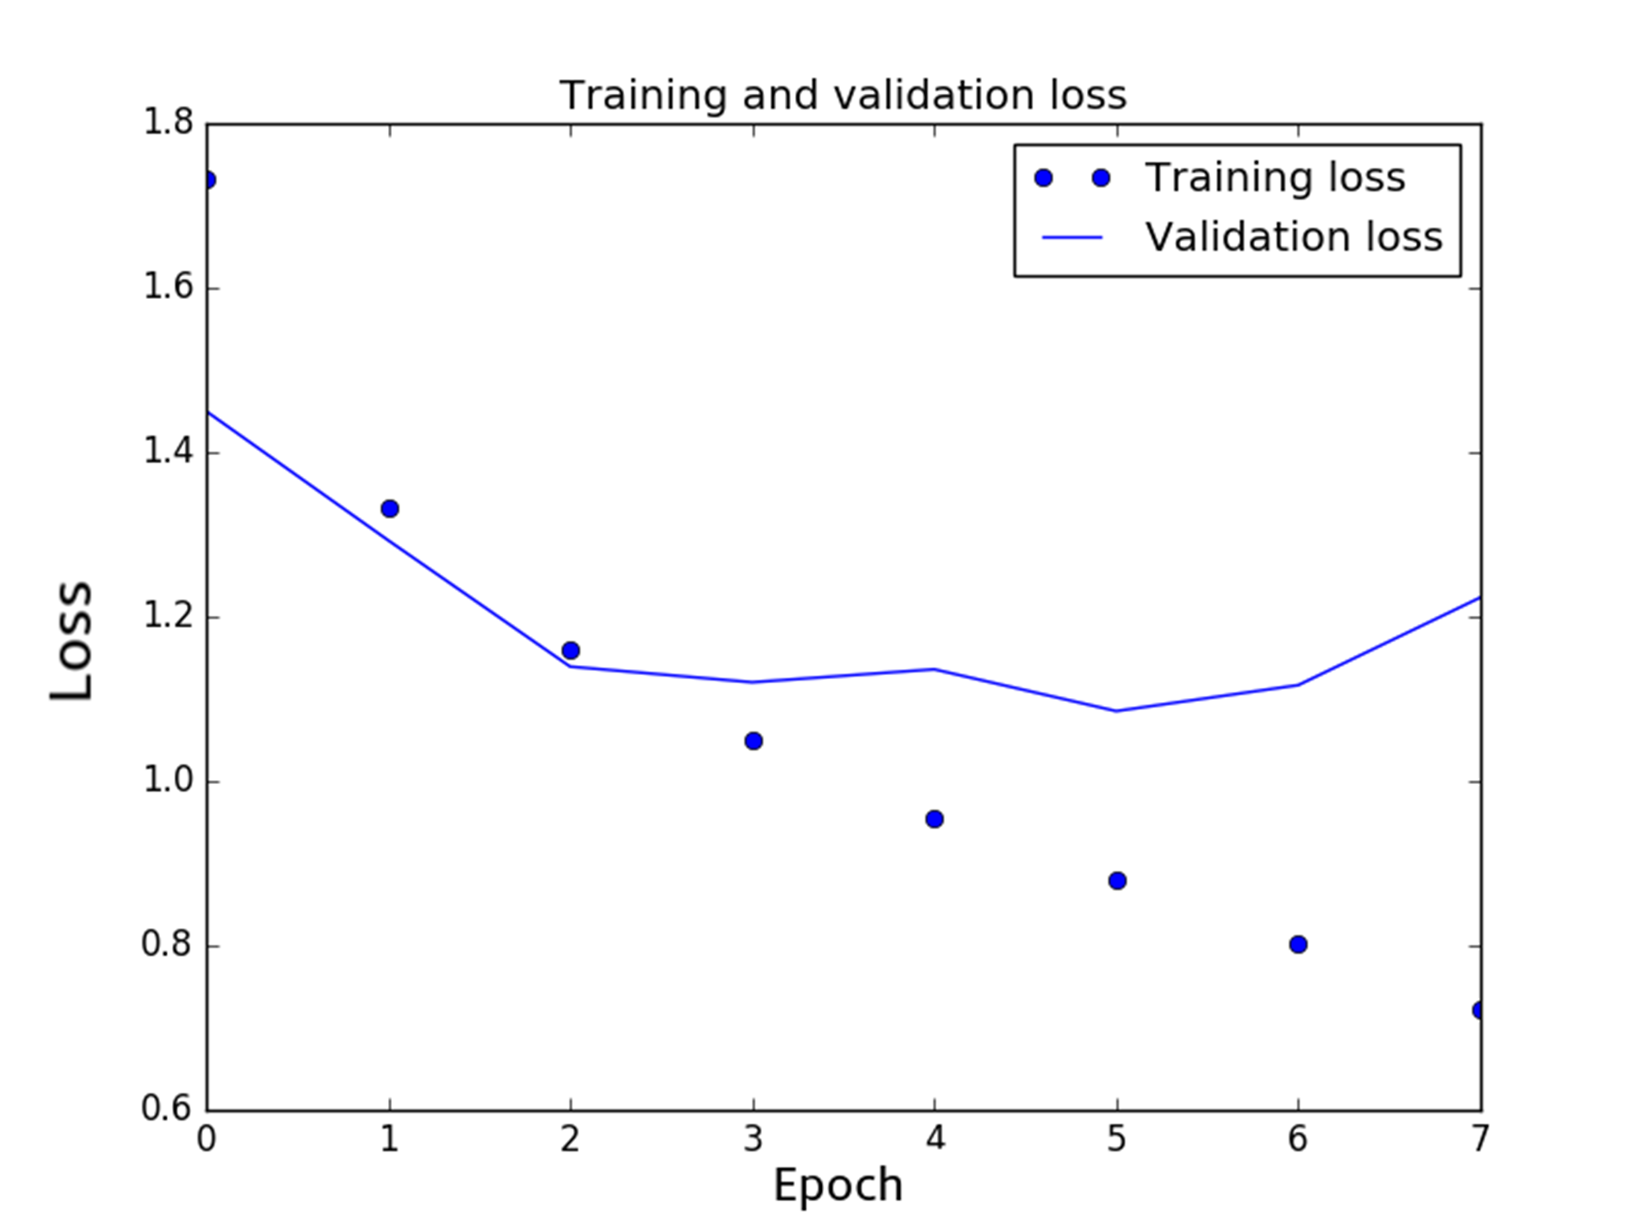
Loss and accuracy per epoch

Slide 14
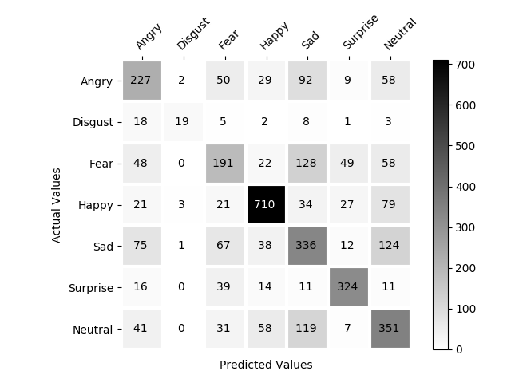
Confusion matrix for the test set

Slide 15
Gif of results

Slide 16
Conclusion
An approach for FER using CNN has been discussed.
A test accuracy of 0.6012 and a validation accuracy of 0.8978 was achieved.
This state-of-the-art model has been used for classifying emotions of users in real time using a webcam.

Slide 17
References
Notes:
Methodology:
1. Dataset – sample extracted image, dataset description table, number of images.
2. Process – flowchart image
pre-processing – gray scaling, resizing, normalization
face detection – haar cascades, haar features, how they are computed?
emotion classification – CNN (how to describe, what to write)
transfer learning – webcam, gif of realtime results
Results:
Table showing results
Confusion matrix
Comparison with related work
Loss and accuracy graph?

